Slide 1

Data analysis in business context
Hotel Business Financial Analysis
Data analyst
Wageeh Hella

Slide 2
Excel In The Business Context
Hotel Business Problem
A mid-sized hotel faces challenges in managing bookings from various channels, including Online Travel Agencies (OTAs), direct bookings through the hotel's website, and traditional travel agents. The hotel's management aims to better understand these financial impacts to optimize their channel strategy, reduce costs, and enhance profitability.

Slide 3
Study of hotel financial report
What are year-round revenue?
What is the total ( revenue, profit, commission)?
What is number of Booking Orders per 2023 ?
What is the total commission paid for each booking channel?
What is the total profit paid to each channel?
Comparison between profit and revenue per channel .
Comparison between profit and revenue per room type
What is the total booking orders percentage per channel?

Slide 4
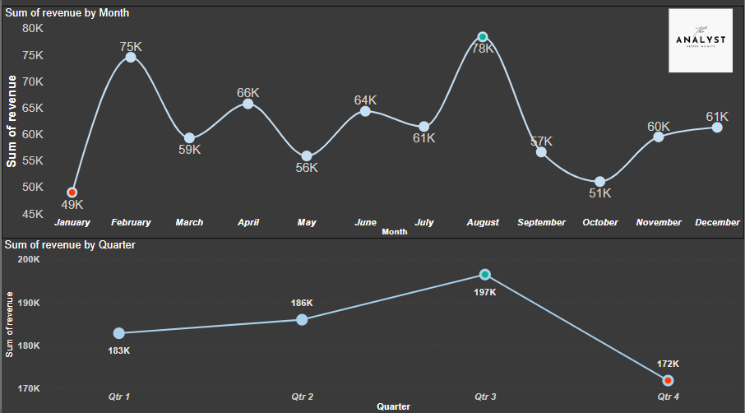
What are year-round revenue?

Slide 5
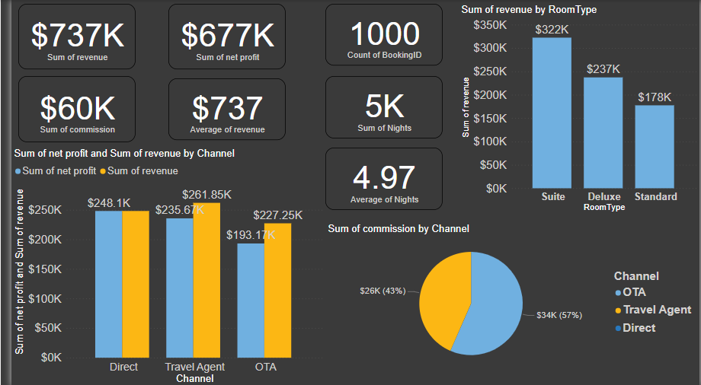
What is the total( revenue, profit, commission)?

Slide 6
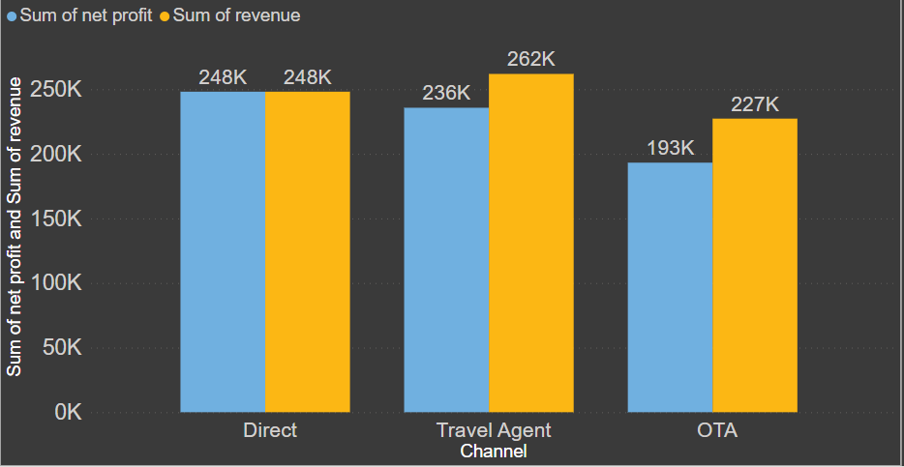
Comparison between profit and revenue per channel .

Slide 7
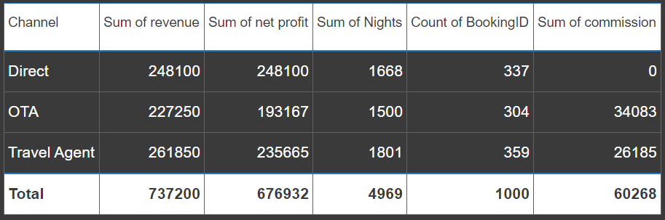
What is the total commission paid for each booking channel?

Slide 8
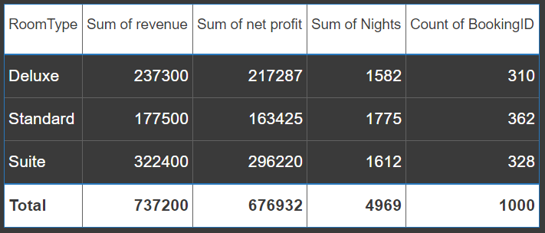
Comparison between profit and revenue per roomtype

Slide 9
Recommendation for increase the profit
Use targeted marketing campaigns to attract high-value customers, such as business travelers or luxury vacationers.
Improve the service in the Hotel and take care of the other Room types (Deluxe and Suite ) to attract the Clients to stay more nights on them
Create special offers and packages to attract different market segments, such as family vacation packages

Slide 10
Recommendation for increase the profit
Develop and promote spa services, fitness centers, and recreational activities to enhance guest experience and increase revenue from non-room services
Invest on Marketing for Travel Agent channel As it’s the highest booking channel

Slide 11
Thank you!!

